Slide 1
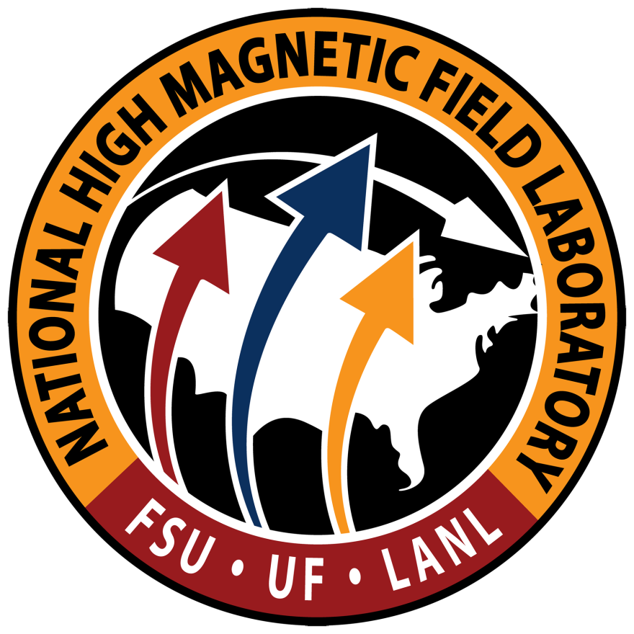

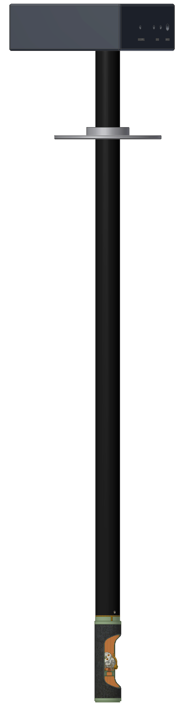
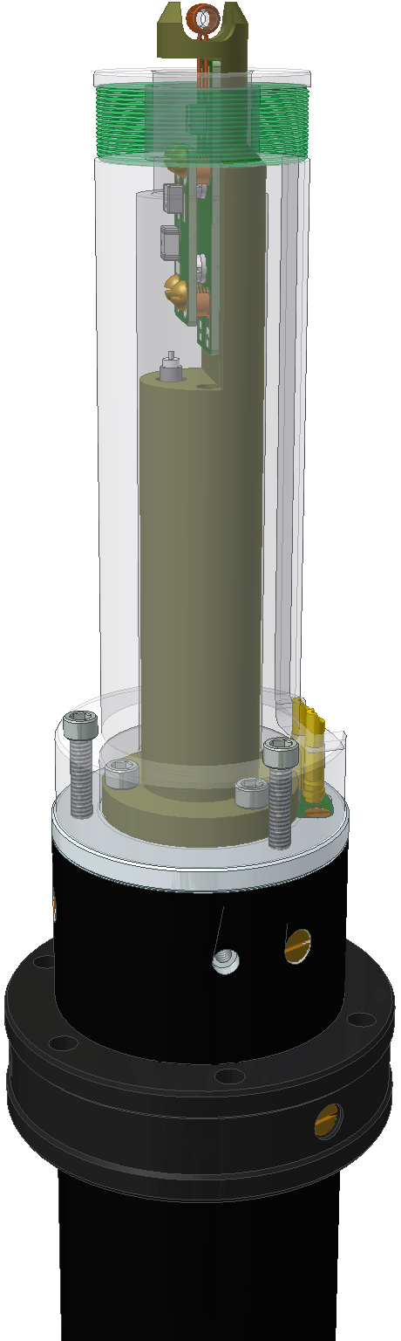
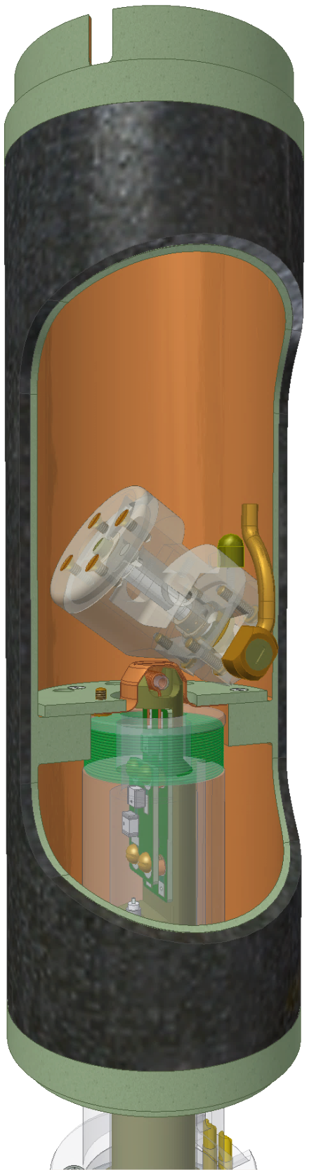
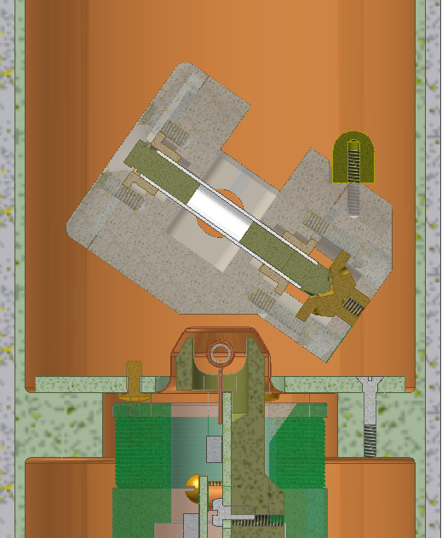
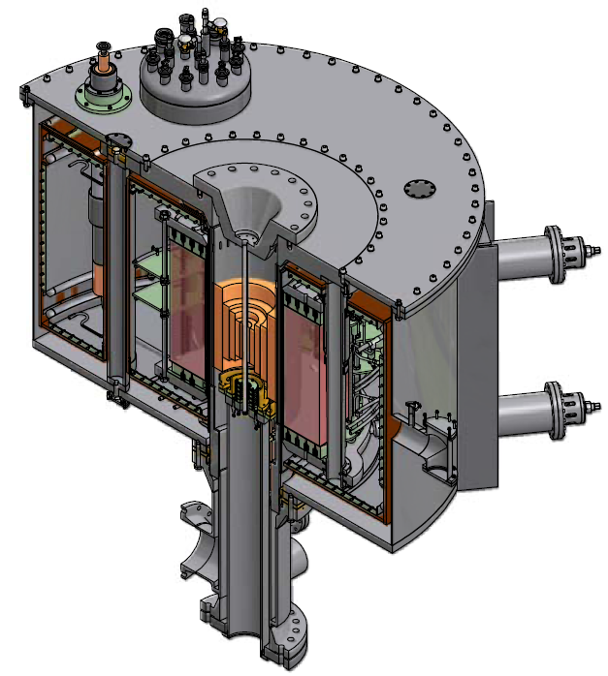
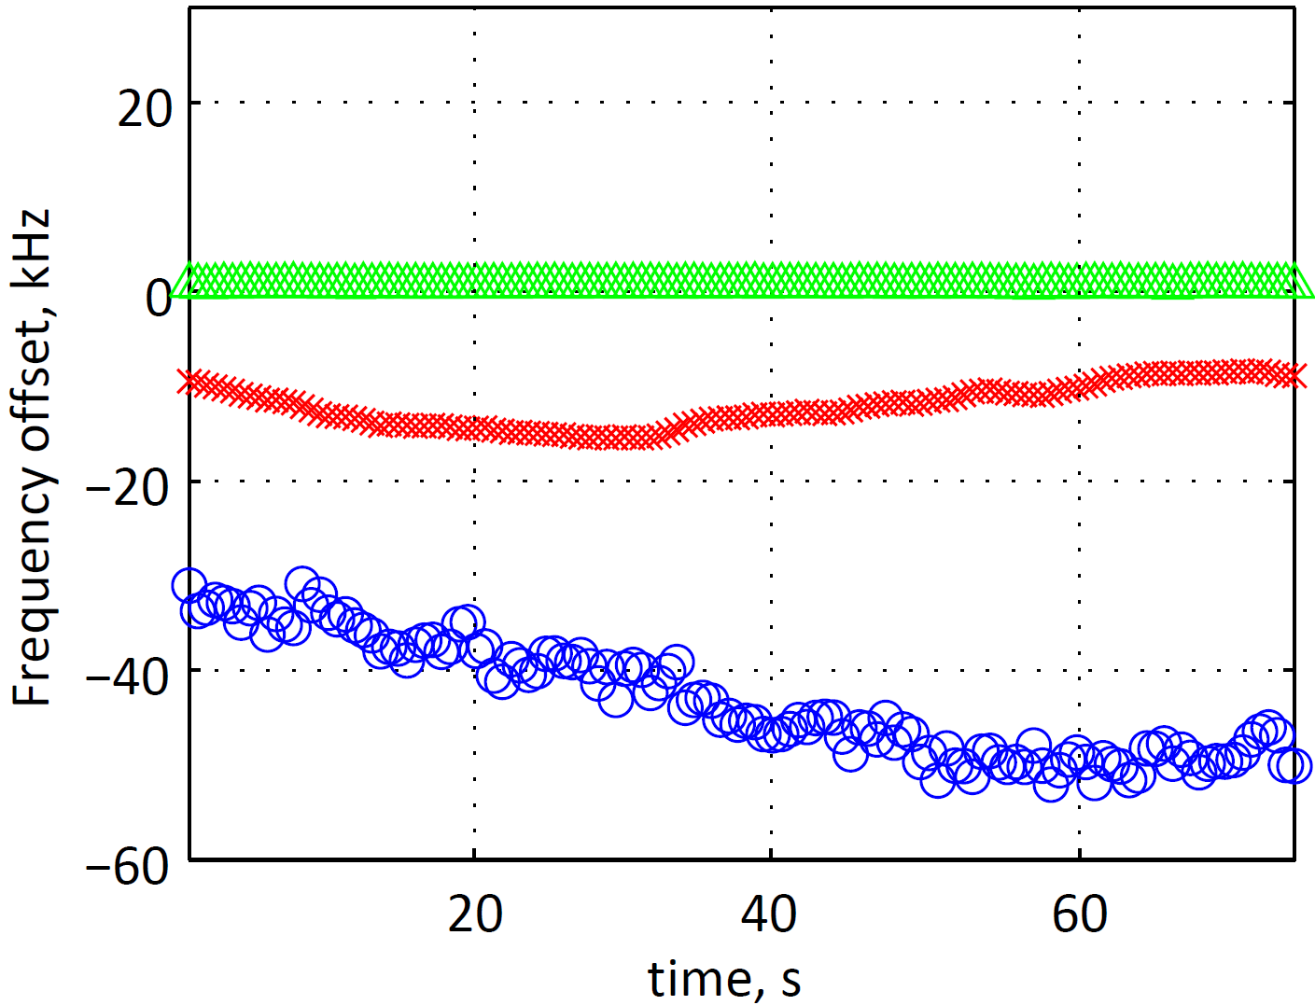


NMR hardware development for the 1.5 GHz series-connected hybrid (SCH) magnet at the National High Magnetic Field Laboratory
Ilya M. Litvak¹, Peter L. Gor’kov¹, Jeffrey L. Schiano², Benjamin D. McPheron², Zhehong Gan¹, Jack Toth¹, William W. Brey¹
1) National High Magnetic Field Laboratory, Florida State University, Tallahassee, FL 32310, USA; 2) Pennsylvania State University, University Park, PA 16802, USA
Introduction
Field regulation system
Probes for the SCH magnet
Ultrahigh magnetic fields open possibilities in NMR beyond incremental improvement in sensitivity for important classes of isotopes.
Elements with half-integer quadrupolar isotopes are abundant in biomolecules (¹⁷O), transition metal complexes, and materials, including zeolites and glasses. Line width of the central transition of these nuclei is inversely proportional to their Larmor frequency. This effect has been shown to substantially improve sensitivity and resolution of ¹⁷O and ²⁷Al NMR spectra at high fields [1,2].
Despite the advances in MAS speed, proton-proton dipolar couplings still hinder the resolution of the ¹H solid state NMR spectra. However, since the strength of the dipolar couplings is field-independent, spectral resolution improves at high fields.
Currently, commercial NMR magnets above 23.5 T are not available. A new 36 T (1.5 GHz) magnet is under construction at the National High Magnetic Field Laboratory in Tallahassee, FL. This magnet will be available to research groups in the US and abroad as part of NMR user program at the NHMFL.
We are developing a set of solid state NMR probes for the SCH magnet. All probes will load from the top of the magnet. The probes will share a probe cap on which a set of passive shims is mounted. The probe cap will also mate to the field regulation probe mounted just below the magnet’s center of the field.
A conventional NMR magnet contains a set of superconducting wire coils operated in persistent current mode, without an external power source. The magnetic field is typically very stable except a very slow drift. In contrast, DC powered magnets suffer from the fluctuations of the magnetic field coming from the power source. Fluctuations in the temperature and flow velocity of the cooling water add magnetic field variation on a slower scale.
The SCH magnet will have an active field regulation system that will suppress magnetic field fluctuations. The measurement part of the system is a dedicated field regulation probe. The probe features a single-channel NMR lock circuit and an inductive pickup coil. The probe mounts just below the center of the field of the magnet, and mates to the NMR probes inserted from above. The NMR lock signal follows slow variations of the magnetic field, while the pickup coil senses faster components of the field fluctuations [5]. Together they form the basis of the two-loop field regulation cascade. The field regulation system drives a Z₀ shim coil to correct fluctuations in the external magnetic field. Experimental data collected in the all-resistive 25 T Keck magnet show that the algorithm reduces field fluctuations by more than two orders of magnitude, from 5.72 ppm rms to 0.0394 ppm rms.
NMR lock sample coil
Flux pickup coil
All NMR probes will load from the top of the magnet
Screw-on circuit board. A different board will be used for each operating magnetic field
MAS spinner is designed to give the lock sample room close to the center of the field
SCH magnet at NHMFL
Commercially built superconductive NMR magnets achieve a field of at most 23.5 T. It is hard to exceed this field strength due to physical limitations of the Nb₃Sn superconducting wire used in high field sections of the NMR magnets. Higher magnetic fields can be produced in resistive magnets and in the more efficient superconductive-resistive hybrids. A hybrid magnet has a water-cooled resistive insert placed inside the bore of a superconductive magnet. The world-record for a continuous magnetic field belongs to the 45 T hybrid magnet at the National High Field Magnetic Field Laboratory in Tallahassee, FL.
cm
1
0
Field regulation probe for the SCH magnet will be mounted below the NMR probe
1
2
Temporal field fluctuations in 25T Keck resistive magnet with and without field regulation
Different probes share the probe cap.
Probe cap forms a RF shield between the NMR probe and the field regulation probe
No feedback
Inductive and NMR feedback
Probe cap cutout
A new series-connected hybrid (SCH) magnet is under construction at the National High Magnetic Field Laboratory in Tallahassee, FL. The name implies that it will have its superconductive and resistive coils connected in series. The magnet will consume 13 MW of power to produce magnetic field of 36 T in its 48-mm bore. The magnet is scheduled to go in operation in 2016 [3].
Inductive feedback only
NMR frequencies (MHz) at high magnetic fields
 | 23.5 T | 28.2 T | 35.25 T
¹H | 1000 | 1200 | 1500
¹⁹F | 941 | 1129 | 1411
³¹P | 404.8 | 485.8 | 607.2
⁷Li | 388.6 | 466.4 | 583.0
²⁷Al | 260.6 | 312.7 | 390.9
¹³C | 251.5 | 301.7 | 377.2
²H | 153.5 | 184.2 | 230.3
¹⁷O | 135.6 | 162.7 | 203.3
¹⁵N | 101.4 | 121.6 | 152.1
³⁹K | 46.7 | 56.0 | 70.0
Solid state NMR probes in development
Low-gamma probe: Single-channel 3.2mm MAS probe with a wide VT range for low-gamma nuclei, e.g. ¹⁷O
Static probe for oriented samples: HX (¹H-¹⁵N) static Low-E probe with VT
CP MAS probe: HX (¹H-¹³C) direct detect MAS probe based on Low-E design
NHMFL SCH magnet
Unlike typical resistive and hybrid magnets which are designed for peak field and have only ppt homogeneity, the SCH magnet will have current-density grading in the coils to provide 1 ppm homogeneity over a 10 mm diameter-spherical volume, a level suitable for many solid state and imaging NMR applications [4].
5. Li, M.; Schiano, J.L.; Samra, J.E.; Shetty, K.K. and Brey, W.W., Reduction of Magnetic Field Fluctuations in Powered Magnets for NMR Using Inductive Measurements and Sampled-Data Feedback Control, J. Magn. Reson., 212 (2), 254-264 (2011)
Acknowledgements
NMR user program at NHMFL
T.H. Sefzik, J.B. Houseknecht, T.M. Clark, S. Prasad, T.L. Lowary, Z. Gan, P.J. Grandinetti Solid-state ¹⁷O NMR in carbohydrates, Chem. Phys. Lett. 434 (2007) 312–315
Z.Gan, P.L.Gor’kov, T.A.Cross, A.Samoson, D. Massiot Seeking higher resolution and sensitivity for NMR of quadrupolar nuclei at ultrahigh magnetic fields JACS 124 (2002), 5634
3. M.D. Bird CICC Magnet Development at the NHMFL, IEEE Trans. on Supercond. 22 (2012) 4300504
4. M.D. Bird, S.Bole, J.R. Miller and J.Toth The Next Generations of Powered Solenoids at the NHMFL IEEE Trans. On Appl. Supercond. 16 (2006) 973-976.
The NHMFL provides an opportunity for research groups in the US and abroad to access its NMR equipment. Proposals for magnet time are accepted throughout the year. Magnet time is granted based on the scientific merit of the project through a peer-review process, and is available at no charge.
Calculated on-axis magnetic field profile of the NHMFL 36T series connected hybrid magnet, unshimmed
This work was supported by the National Science Foundation through DMR-0603042 and DMR-1039938 awards. A portion of this work was performed at the National High Magnetic Field Laboratory, which is supported by the NSF through Cooperative Agreement DMR-1157490 and by the State of Florida. The SCH magnet design and construction is the effort of the Hybrid Magnet Project Team at the NHMFL.

